Slide 1
INTER PROCESS COMMUNICATION

Slide 2
Introduction
Interprocess communication in the Internet provides both datagram and stream communication.
The interprocess communication primitives support point-to-point communication, yet it is equally useful to be able to send a message from one sender to a group of receivers.
Multicast is an important requirement for distributed applications and must be provided even if underlying support for IP multicast is not available.
This is typically provided by an overlay network constructed on top of the underlying TCP/IP network.
Overlay networks can also provide support for file sharing, enhanced reliability and content distribution.

Slide 3
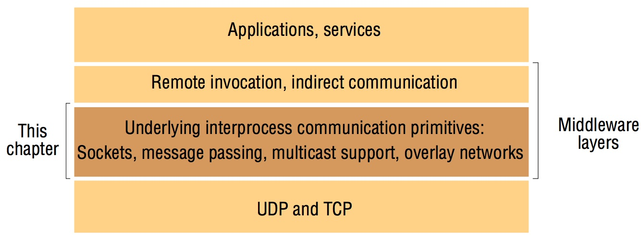
Middleware Layers

Slide 4
Introduction (cont.)
In this chapter we will see how middleware and application programs can use transport level protocols UDP and TCP.
The application program interface to UDP provides a message passing abstraction – the simplest form of interprocess communication. This enables a sending process to transmit a single message to a receiving process.
The independent packets containing these messages are called datagrams. In the Java and UNIX APIs, the sender specifies the destination using a socket – an indirect reference to a particular port used by the destination process at a destination computer.
The application program interface to TCP provides the abstraction of a two-way stream between pairs of processes. The information communicated consists of a stream of data items with no message boundaries.

Slide 5
Introduction (cont.)
Streams provide a building block for producer-consumer communication.
A producer and a consumer form a pair of processes in which the role of the first is to produce data items and the role of the second is to consume them.
The data items sent by the producer to the consumer are queued on arrival at the receiving host until the consumer is ready to receive them.
The consumer must wait when no data items are available. The producer must wait if the storage used to hold the queued data items is exhausted.

Slide 6
The API for the Internet Protocols
We will discuss
The general characteristics of inter process communication.
Data transmission through UDP messages or TCP streams.

Slide 7
Characteristics of Interprocess Communication
Message passing between a pair of processes can be supported by two message communication operations, send and receive, defined in terms of destinations and messages.
To communicate, one process sends a message (a sequence of bytes) to a destination and another process at the destination receives the message.
This activity involves the communication of data from the sending process to the receiving process and may involve the synchronization of the two processes.

Slide 8
Operations provided in Inter process Communications API
Receive ( [sender], message storage object)
Connect (sender address, receiver address), for connection-oriented communication.
Send ( [receiver], message)
Disconnect (connection identifier), for connection-oriented communication.

Slide 9
Inter process Communication in basic HTTP
Processing order: C1, S1, C2, S2, S3, C3, C4, S4

Slide 10
Synchronous and Asynchronous Communication
A queue is associated with each message destination. Sending processes cause messages to be added to remote queues and receiving processes remove messages from local queues.
In the synchronous form of communication, both send and receive are blocking operations.
A blocking operation issued by a process will block further processing of the process until the operation is fulfilled.
Whenever a send is issued the sending process (or thread) is blocked until the corresponding receive is issued.
Whenever a receive is issued by a process (or thread), it blocks until a message arrives.
An asynchronous operation issued by a process will not block further processing of the process. Instead, the process is free to proceed with its processing, and may optionally be notified by the system when the operation is fulfilled.

Slide 11
Synchronous send and receive

Slide 12
Synchronous and Asynchronous Communication (cont.)
In the asynchronous form of communication, the use of the send operation is non-blocking in that the sending process is allowed to proceed as soon as the message has been copied to a local buffer, and the transmission of the message proceeds in parallel with the sending process.
The receive operation can have blocking and non-blocking variants. In the non-blocking variant, the receiving process proceeds with its program after issuing a receive operation, which provides a buffer to be filled in the background, but it must separately receive notification that its buffer has been filled, by polling or interrupt.

Slide 13
Asynchronous send and synchronous receive

Slide 14
Synchronous and Asynchronous Communication (cont.)
In a system environment such as Java, which supports multiple threads in a single process, the blocking receive has no disadvantages, for it can be issued by one thread while other threads in the process remain active, and the simplicity of synchronizing the receiving threads with the incoming message is a substantial advantage.

Slide 15
Message Destinations
Messages are sent to (Internet address, local port) pairs. A local port is a message destination within a computer, specified as an integer.
A port has exactly one receiver (multicast ports are an exception) but can have many senders. Processes may use multiple ports to receive messages. Any process that knows the number of a port can send a message to it. Servers generally publicize their port numbers for use by clients.
If the client uses a fixed Internet address to refer to a service, then that service must always run on the same computer for its address to remain valid.

Slide 16
Message Destinations (cont.)
This can be avoided by using the following approach to providing location transparency:
Client programs refer to services by name and use a name server or to translate their names into server locations at runtime. This allows services to be relocated but not to migrate – that is, to be moved while the system is running.

Slide 17
Reliability
reliable communication in terms of validity and integrity.
As far as the validity property is concerned, a point-to-point message service can be described as reliable if messages are guaranteed to be delivered despite a ‘reasonable’ number of packets being dropped or lost.
In contrast, a point-to-point message service can be described as unreliable if messages are not guaranteed to be delivered in the face of even a single packet dropped or lost.
For integrity, messages must arrive uncorrupted and without duplication.

Slide 18
Ordering
Some applications require that messages be delivered in sender order– that is, the order in which they were transmitted by the sender.
The delivery of messages out of sender order is regarded as a failure by such applications.

Slide 19
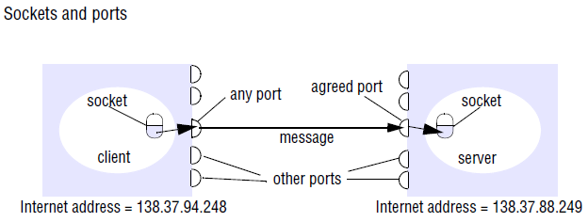
Sockets
Both forms of communication (UDP and TCP) use the socket abstraction, which provides an endpoint for communication between processes.
Interprocess communication consists of transmitting a message between a socket in one process and a socket in another process, as illustrated in Figure.

Slide 20
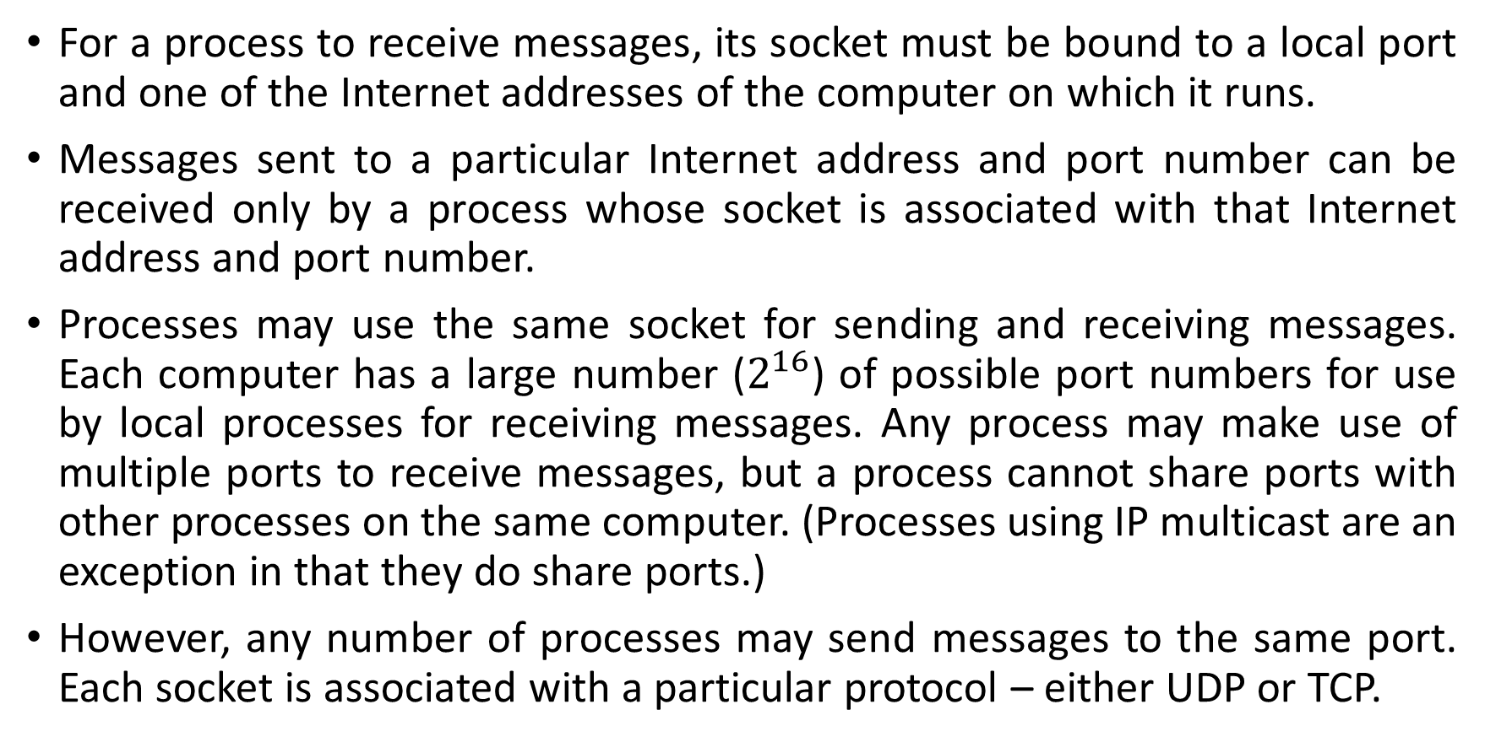
Sockets (cont.)
For a process to receive messages, its socket must be bound to a local port and one of the Internet addresses of the computer on which it runs.
Messages sent to a particular Internet address and port number can be received only by a process whose socket is associated with that Internet address and port number.
Processes may use the same socket for sending and receiving messages. Each computer has a large number ($2^{16}$) of possible port numbers for use by local processes for receiving messages. Any process may make use of multiple ports to receive messages, but a process cannot share ports with other processes on the same computer. (Processes using IP multicast are an exception in that they do share ports.)
However, any number of processes may send messages to the same port. Each socket is associated with a particular protocol – either UDP or TCP.

Slide 21
Java API for Internet Addresses
As the IP packets underlying UDP and TCP are sent to Internet addresses, Java provides a class, InetAddress, that represents Internet addresses.
Java InetAddress class represents an IP address. Users of this class refer to computers by Domain Name System (DNS) hostnames.
The java.net.InetAddress class provides methods to get the IP of any host name for example www.javatpoint.com, www.google.com, www.facebook.com, etc.
An IP address is represented by 32-bit or 128-bit unsigned number.
An instance of InetAddress represents the IP address with its corresponding host name. There are two types of addresses: Unicast and Multicast.
The Unicast is an identifier for a single interface whereas Multicast is an identifier for a set of interfaces.
For example, instances of InetAddress that contain Internet addresses can be created by calling a static method of InetAddress, giving a DNS hostname as the argument.

Slide 22
Java API for Internet Addresses
The method uses the DNS to get the corresponding Internet address. For example, to get an object representing the Internet address of the host whose DNS name is bruno.dcs.qmul.ac.uk, use:
InetAddress aComputer = InetAddress.getByName("bruno.dcs.qmul.ac.uk");
This method can throw an UnknownHostException. Note that the user of the class does not need to state the explicit value of an Internet address.
In fact, the class encapsulates the details of the representation of Internet addresses. Thus the interface for this class is not dependent on the number of bytes needed to represent Internet addresses – 4 bytes in IPv4 and 16 bytes in IPv6.

Slide 23
Java InetAddress Class Methods
Host Name: www.javatpoint.com IP Address: 172.67.196.82
Host Name: www.javatpoint.com IP Address: 172.67.196.82
public static InetAddress getByName(String host) throws UnknownHostException : It returns the instance of InetAddress containing LocalHost IP and name.
Example:
import java.io.*;
import java.net.*;
public class InetDemo{ Host Name: www.javatpoint.com
IP Address: 172.67.196.82
public static void main(String[] args){
try{
InetAddress ip=InetAddress.getByName("www.javatpoint.com");
System.out.println("Host Name: "+ip.getHostName());
System.out.println("IP Address: "+ip.getHostAddress());
}catch(Exception e){System.out.println(e);}
}
}
Output:

Slide 24
TCP Sockets
The client thread’s socket specifies a local IO port to be used for sending messages (or the IO port can be chosen by the operating system).
The client’s socket also specifies the address of the destination machine and the port number that is expected to be bound to the server thread’s socket.
The server’s socket specifies a local IO port for receiving messages. Messages can be received from any client that knows both the server’s machine address and the port number bound to the server’s socket.
The client issues a request to the server to form a connection between the two sockets. Once the server accepts the connection request, messages can be passed in either direction across the channel.

Slide 25
java.net.Socket Class
Create socket objects that help us in implementing all fundamental socket operations.
Used to perform various networking operations such as sending, reading data and closing connections.
Each Socket object is associated exactly with 1 remote host, for connecting to another different host.
import java.net.Socket;
Socket class is implemented in creating a stream socket and which is connected to a specified port number and port address.
public Socket(InetAddress address, int port)
getInputStream(): This method returns the input stream for the socket.
getOutputStream(): This method returns the output stream for the socket.

Slide 26
Java.io.PrintWriter Class
This class gives Prints formatted representations of objects to a text-output stream. It implements all of the print methods found in PrintStream.
Constructor:
PrintWriter(OutputStream out, boolean autoFlush): Creates a new PrintWriter from an existing OutputStream.

Slide 27
TCP Sockets in Java
Class Socket : A client’s first step is to create a TCP socket and try to connect to the server
InetAddress host; // server’s machine address
int serverPort = 2020; // port number bound to server’s socket
Socket socket; // client’s socket
try {host = InetAddress.getByName(“www.cs.gmu.edu”); }
catch (UnknownHostException) { … }
try {socket = new Socket(host,serverPort); } // create a socket and request a connection to host
catch (IOException e) { … } //
The client assumes that the server is listening for TCP connection requests on port serverPort.
The Socket constructor throws an IOException if it cannot make a connection.

Slide 28
Client creates:
an input stream to receive data from its socket & an output stream to send data to the socket at the server’s end of the channel. (Looks like file I/O!)
PrintWriter toServer = new PrintWriter(socket.getOutputStream(),true);
BufferedReader fromServer = new BufferedReader(new
inputStreamReader(socket.getInputStream()));
toServer.println("Hello"); // send a message to the server
String line = fromServer.readLine(); // receive the server’s reply
System.out.println ("Client received: " + line + “ from Server”);
toServer.close();
fromServer.close();
socket.close();

Slide 29
Class ServerSocket
The server begins by creating a ServerSocket.
int serverPort = 2020;
ServerSocket listen;
try { listen = new ServerSocket(serverPort); }
catch (IOException e) { … }

Slide 30
Class ServerSocket
The server then calls the accept() method of the ServerSocket:
method accept() waits until a client requests a connection
it then returns a Socket that connects the client to the server
server gets input and output streams and communicates with the client.
client, server, or both, close the connection, and the server waits for a connection request from another client.

Slide 31
try {
listen = new ServerSocket(serverPort);
while (true) {
Socket socket = listen.accept(); // wait for a client request
toClient = new PrintWriter(socket.getOutputStream(),true);
fromClient = new BufferedReader(new InputStreamReader(socket.getInputStream()));
String line = fromClient.readLine(); // receive a message from the client
System.out.println("Server received " + line);
toClient.println("Good-bye"); // send a reply to the client
}}
catch (IOException e) { … }
finally { if (listen != null) try { listen.close();}
catch (IOException e) { e.printStackTrace(); }}

Slide 32
Class ServerSocket
The server can create a separate thread to handle the client’s requests.
Socket socket = listen.accept();
clientHandler c = new clientHandler(socket); // clientHandler extends Thread
c.start();
The run() method of class clientHandler uses input and output streams obtained from the socket to communicate with the client, exactly as shown above.

Slide 33
A client and server program using TCP sockets
..\..\TCP CLIENT AND SERVER SOCKET PROGRAM_CHAPTER 4.docx

Slide 34
UDP Datagram Communication
A datagram sent by UDP is transmitted from a sending process to a receiving process without acknowledgement or retries. If a failure occurs, the message may not arrive.
To send or receive messages, a process must first create a socket bound to an Internet address of the local host and a local port. A server will bind its socket to a server port – one that it makes known to clients so that they can send messages to it.
A client binds its socket to any free local port. The receive method returns the Internet address and port of the sender, in addition to the message, allowing the recipient to send a reply.

Slide 35
Issues in UDP Datagram Communication (cont.)
Message size:
The receiving process needs to specify an array of bytes of a particular size in which to receive a message. If the message is too big for the array, it is truncated on arrival.
The underlying IP protocol allows packet lengths of up to 216 bytes, which includes the headers as well as the message. However, most environments impose a size restriction of 8 kilobytes. Any application requiring messages larger than the maximum must fragment them into chunks of that size.
Generally, an application, for example DNS, will decide on a size that is not excessively large but is adequate for its intended use.

Slide 36
Issues in UDP Datagram Communication (cont.)
Blocking:
Sockets normally provide non-blocking sends and blocking receives for datagram communication. The send operation returns when it has handed the message to the underlying UDP and IP protocols, which are responsible for transmitting it to its destination.
On arrival, the message is placed in a queue for the socket that is bound to the destination port.
The message can be collected from the queue by an outstanding or future invocation of receive on that socket.
Messages are discarded at the destination if no process already has a socket bound to the destination port.
The method receive blocks until a datagram is received, unless a timeout has been set on the socket.
If the process that invokes the receive method has other work to do while waiting for the message, it should arrange to use a separate thread.
For example, when a server receives a message from a client, the message may specify work to do, in which case the server will use separate threads to do the work and to wait for messages from other clients.

Slide 37
Issues in UDP Datagram Communication (cont.)
Timeouts:
The receive that blocks forever is suitable for use by a server that is waiting to receive requests from its clients. But in some programs, it is not appropriate that a process that has invoked a receive operation should wait indefinitely in situations where the sending process may have crashed or the expected message may have been lost.
To allow for such requirements, timeouts can be set on sockets. Choosing an appropriate timeout interval is difficult, but it should be fairly large in comparison with the time required to transmit a message.

Slide 38
Issues in UDP Datagram Communication (cont.)
Receive from any:
The receive method does not specify an origin for messages. Instead, an invocation of receive gets a message addressed to its socket from any origin.
The receive method returns the Internet address and local port of the sender, allowing the recipient to check where the message came from.
It is possible to connect a datagram socket to a particular remote port and Internet address, in which case the socket is only able to send messages to and receive messages from that address.

Slide 39
Failure Model for UDP Datagrams
A failure model for communication channels and defines reliable communication in terms of two properties: integrity and validity.
The integrity property requires that messages should not be corrupted or duplicated. The use of a checksum ensures that there is a negligible probability that any message received is corrupted. UDP datagrams suffer from the following failures:
Omission failures: Messages may be dropped occasionally, either because of a checksum error or because no buffer space is available at the source or destination. To simplify the discussion, we regard send-omission and receive-omission failures as omission failures in the communication channel.
Ordering: Messages can sometimes be delivered out of sender order.
Applications using UDP datagrams are left to provide their own checks to achieve the quality of reliable communication they require. A reliable delivery service may be constructed from one that suffers from omission failures by the use of acknowledgements.

Slide 40
Use of UDP
For some applications, it is acceptable to use a service that is liable to occasional omission failures.
For example, the Domain Name System, which looks up DNS names in the Internet, is implemented over UDP. Voice over IP (VOIP) also runs over UDP.
UDP datagrams are sometimes an attractive choice because they do not suffer from the overheads associated with guaranteed message delivery. There are three main sources of overhead:
the need to store state information at the source and destination;
the transmission of extra messages;
latency for the sender.

Slide 41

Java API for UDP Datagrams
The Java API provides datagram communication by means of two classes: DatagramPacket and DatagramSocket.
DatagramPacket: This class provides a constructor that makes an instance out of an array of bytes comprising a message, the length of the message and the Internet address and local port number of the destination socket, as follows:

Slide 42
Java API for UDP Datagrams- DatagramPacket (cont.)
An instance of DatagramPacket may be transmitted between processes when one process sends it and another receives it.
This class provides another constructor for use when receiving a message. Its arguments specify an array of bytes in which to receive the message and the length of the array.
A received message is put in the DatagramPacket together with its length and the Internet address and port of the sending socket. The message can be retrieved from the DatagramPacket by means of the method getData.
The methods getPort and getAddress access the port and Internet address.

Slide 43
Java API for UDP Datagrams- DatagramSocket
This class supports sockets for sending and receiving UDP datagrams.
It provides a constructor that takes a port number as its argument, for use by processes that need to use a particular port. It also provides a no-argument constructor that allows the system to choose a free local port.
These constructors can throw a SocketException if the chosen port is already in use or if a reserved port (a number below 1024) is specified when running over UNIX.
The class DatagramSocket provides methods that include the following:
send and receive: These methods are for transmitting datagrams between a pair of sockets. The argument of send is an instance of DatagramPacket containing a message and its destination. The argument of receive is an empty DatagramPacket in which to put the message, its length and its origin. The methods send and receive can throw IOExceptions.

Slide 44
Java API for UDP Datagrams- DatagramSocket (cont.)
setSoTimeout: This method allows a timeout to be set. With a timeout set, the receive method will block for the time specified and then throw an InterruptedIOException.
connect: This method is used for connecting to a particular remote port and Internet address, in which case the socket is only able to send messages to and receive messages from that address.

Slide 45
Java DatagramSocket class
A connection-less socket for sending and receiving datagram packets. It is a mechanism used for transmitting datagram packets over network.
A datagram is basically an information but there is no guarantee of its content, arrival or arrival time.
Constructors of DatagramSocket class
DatagramSocket() throws SocketEeption: it creates a datagram socket and binds it with the available Port Number on the localhost machine.
DatagramSocket(int port) throws SocketEeption: it creates a datagram socket and binds it with the given Port Number.
DatagramSocket(int port, InetAddress address) throws SocketEeption: it creates a datagram socket and binds it with the specified port number and host address.
void send(DatagramPacket p): It sends the datagram packet from the socket.
void receive(DatagramPacket p):It receives the datagram packet from the socket.

Slide 46
Java DatagramPacket Class
Java DatagramPacket is a message that can be sent or received.
It is a data container.
If you send multiple packet, it may arrive in any order. Additionally, packet delivery is not guaranteed.
Constructors of DatagramPacket class:
DatagramPacket(byte[] barr, int length): it creates a datagram packet. This constructor is used to receive the packets.
DatagramPacket(byte[] barr, int length, InetAddress address, int port): it creates a datagram packet. This constructor is used to send the packets.

Slide 47
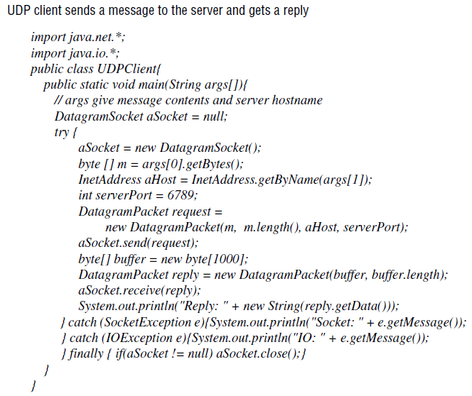

Slide 48
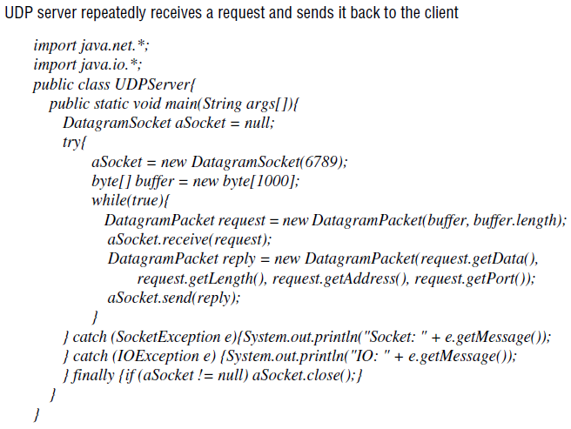

Slide 49
External Data Representation and Marshalling
The information stored in running programs is represented as data structures – for example, by sets of interconnected objects – whereas the information in messages consists of sequences of bytes.
Irrespective of the form of communication used, the data structures must be flattened (converted to a sequence of bytes) before transmission and rebuilt on arrival.
The individual primitive data items transmitted in messages can be data values of many different types, and not all computers store primitive values such as integers in the same order. The representation of floating-point numbers also differs between architectures.

Slide 50
External Data Representation and Marshalling (cont.)
There are two variants for the ordering of integers: the so-called big-endian order, in which the most significant byte comes first; and little-endian order, in which it comes last.
Another issue is the set of codes used to represent characters: for example, the majority of applications on systems such as UNIX use ASCII character coding, taking one byte per character, whereas the Unicode standard allows for the representation of texts in many different languages and takes two bytes per character.

Slide 51
External Data Representation and Marshalling (cont.)
One of the following methods can be used to enable any two computers to exchange binary data values:
The values are converted to an agreed external format before transmission and converted to the local form on receipt; if the two computers are known to be the same type, the conversion to external format can be omitted.
The values are transmitted in the sender’s format, together with an indication of the format used, and the recipient converts the values if necessary.

Slide 52
External Data Representation and Marshalling (cont.)
Bytes themselves are never altered during transmission. To support RMI or RPC, any data type that can be passed as an argument or returned as a result must be able to be flattened and the individual primitive data values represented in an agreed format. An agreed standard for the representation of data structures and primitive values is called an external data representation.
Marshalling is the process of taking a collection of data items and assembling them into a form suitable for transmission in a message. Unmarshalling is the process of disassembling them on arrival to produce an equivalent collection of data items at the destination. Thus marshalling consists of the translation of structured data items and primitive values into an external data representation. Similarly, unmarshalling consists of the generation of primitive values from their external data representation and the rebuilding of the data structures.

Slide 53
External Data Representation and Marshalling (cont.)
Three alternative approaches to external data representation and marshalling are:
CORBA’s common data representation, which is concerned with an external representation for the structured and primitive types that can be passed as the arguments and results of remote method invocations in CORBA. It can be used by a variety of programming languages.
Java’s object serialization, which is concerned with the flattening and external data representation of any single object or tree of objects that may need to be transmitted in a message or stored on a disk. It is for use only by Java.

Slide 54
External Data Representation and Marshalling- alternative approaches (cont.)
XML (Extensible Markup Language), which defines a textual format for representing structured data. It was originally intended for documents containing textual self-describing structured data – for example documents accessible on the Web – but it is now also used to represent the data sent in messages exchanged by clients and servers in web services.

Slide 55
External Data Representation and Marshalling- alternative approaches (cont.)
In the first two cases, the marshalling and unmarshalling activities are intended to be carried out by a middleware layer without any involvement on the part of the application programmer. Even in the case of XML, which is textual and therefore more accessible to hand-encoding, software for marshalling and unmarshalling is available for all commonly used platforms and programming environments. Because marshalling requires the consideration of all the finest details of the representation of the primitive components of composite objects, the process is likely to be error-prone if carried out by hand. Compactness is another issue that can be addressed in the design of automatically generated marshalling procedures.

Slide 56
External Data Representation and Marshalling- alternative approaches (cont.)
In the first two approaches, the primitive data types are marshalled into a binary form. In the third approach (XML), the primitive data types are represented textually. The textual representation of a data value will generally be longer than the equivalent binary representation. The HTTP protocol is another example of the textual approach.
Another issue with regard to the design of marshalling methods is whether the marshalled data should include information concerning the type of its contents. For example, CORBA’s representation includes just the values of the objects transmitted, and nothing about their types. On the other hand, both Java serialization and XML do include type information, but in different ways. Java puts all of the required type information into the serialized form, but XML documents may refer to externally defined sets of names (with types) called namespaces.

Slide 57
External Data Representation and Marshalling- alternative approaches (cont.)
Although we are interested in the use of an external data representation for the arguments and results of RMIs and RPCs, it does have a more general use for representing data structures, objects or structured documents in a form suitable for transmission in messages or storing in files.

